Slide 1

Sentiment analysis of starbucks reviews Temilola Famakinwa

Slide 2
Executive summary
Brian Niccol became Starbucks’ CEO in Sept 2024
Tracking customer sentiment in the first 12 months can give an indication of impact of Niccol’s strategy and vision.
Developed a model for predicting customer sentiment from reviews.
Achieved 81% accuracy in prediction of customer sentiment using a recurrent neural network model.
Potential areas of improvement: customer service, wait times, payment methods and drive thru service.

Slide 3
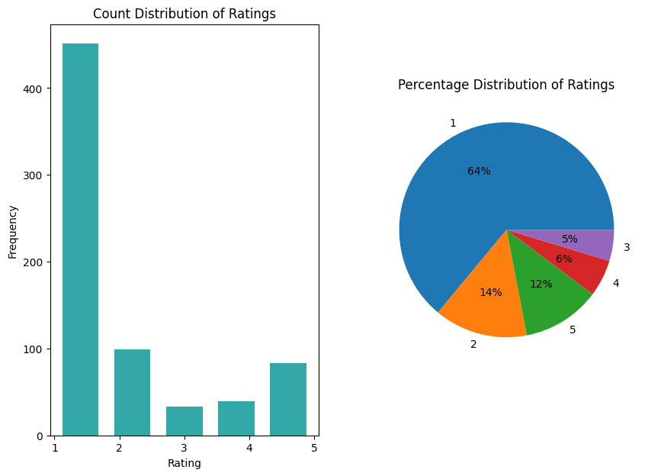
Data
Starbucks Yelp Review (2009 – 2023)¹
850 entries
CSV Format
Imbalance: 78% of reviews are negative
address during modelling.
¹ https://www.kaggle.com/datasets/harshalhonde/starbucks-reviews-dataset

Slide 4
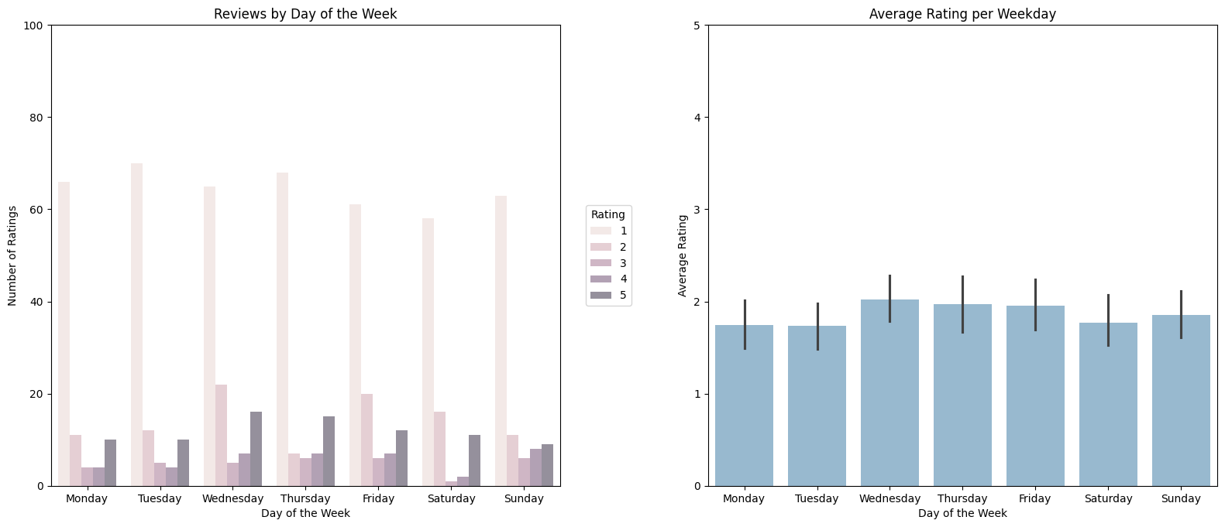
Customer ratings by weekday
Customer ratings are lowest at the beginning of the week and highest in the middle to end of the week.
Do customers have a less optimistic outlook at the beginning of workweek?

Slide 5
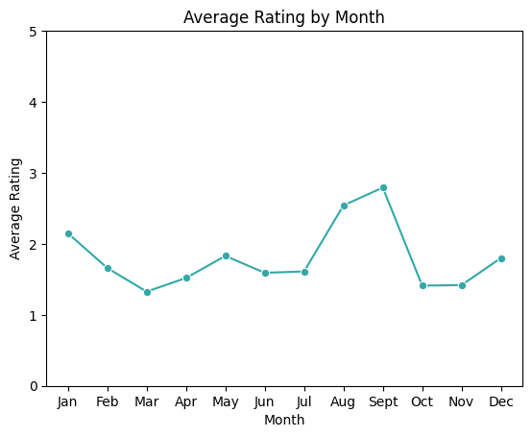
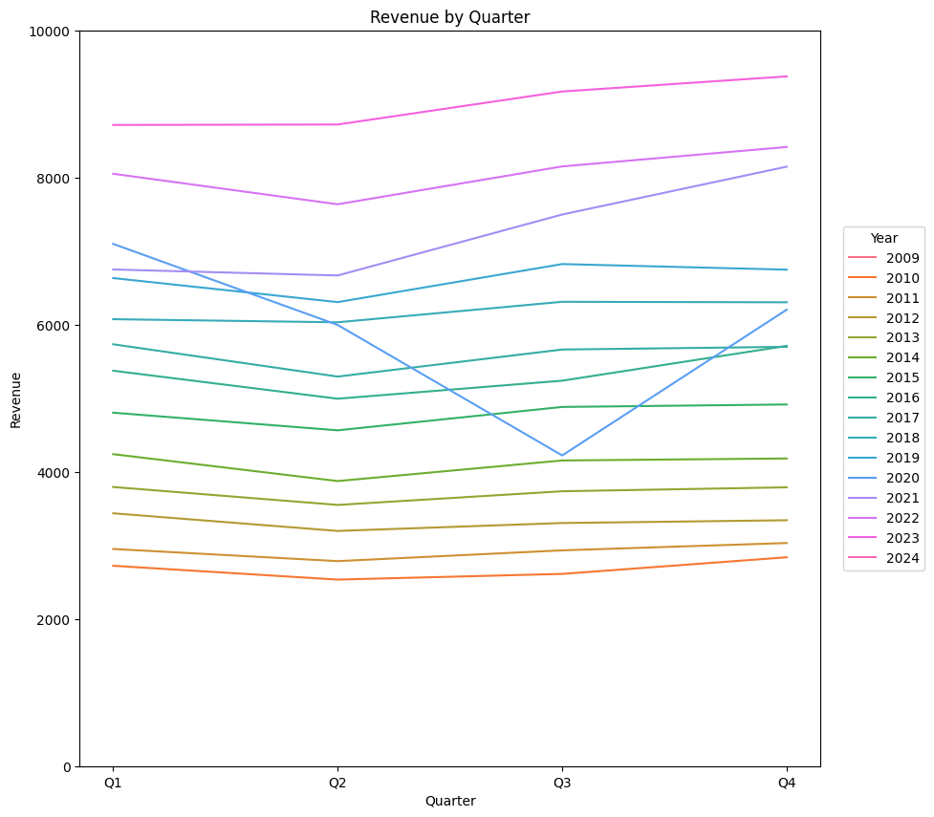
Customer ratings By month
On average, customer ratings peak between August and September during the year.
Revenue¹ shows uptick during Q3 -Q4 (fall/holiday season) annual.
Are ratings in August-September driven by positive outlook associated with the start of the fall/holiday season?
¹https://www.netcials.com/financial-revenue-growth-usa/829224-STARBUCKS-CORP/

Slide 6
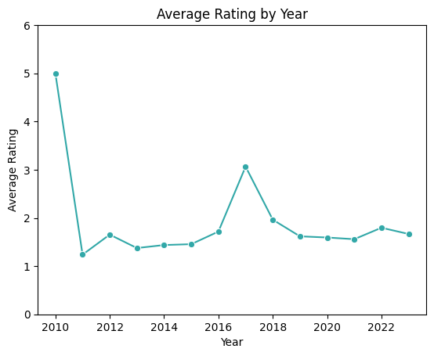
Customer ratings by year
Customer ratings had a noticeable increase in 2017 compared to other years
What programs and initiatives did Starbucks have during 2017?

Slide 7
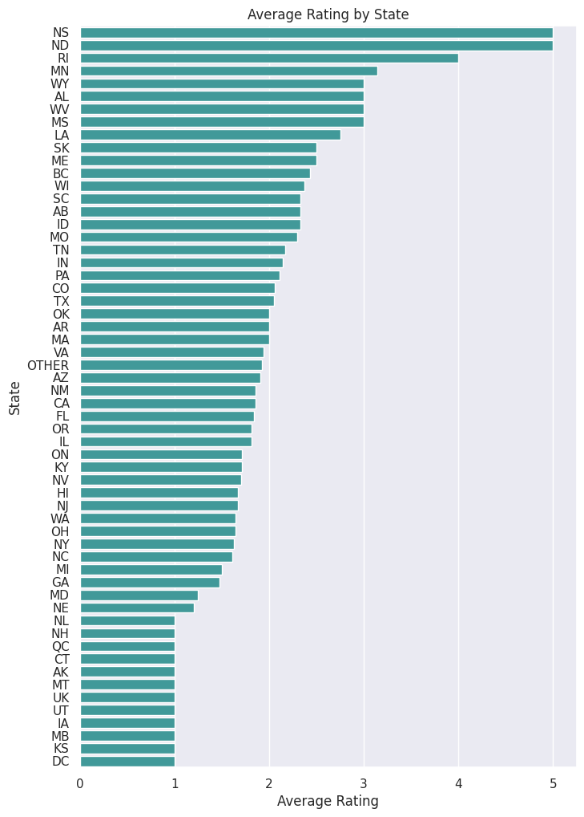
Customer ratings by us/Canadian states & provinces
Highest ratings were recorded in Nova Scotia, North Dakota, and Rhode Island.
Could these ratings be correlated to regional groupings?

Slide 8
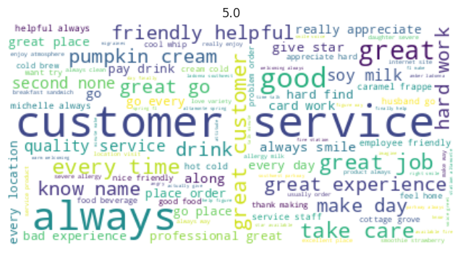
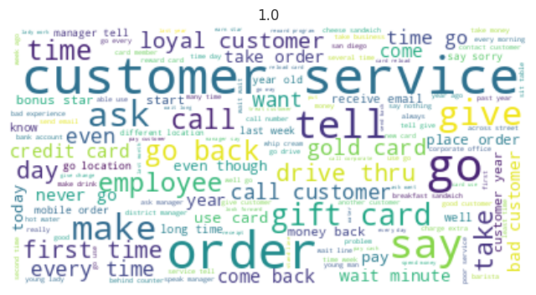
When things go right…
When improvements need to be made…
Good, ‘Professional’ ‘customer service’
Drink ‘variety’, ‘Good food’
‘Atmosphere’, ‘Feels like home’
‘Allergy’ (well taken care of?)
‘Poor’ ‘customer service’
‘Long’ ‘ Wait’ ‘Line’ ‘Time’
‘Bank account’ ‘ Credit Card’ ‘ Gift card’ ‘Mobile order’ ‘Pay’ ‘Reward card’ ‘Gold card’
‘Drive thru’

Slide 9
modelling
Recurrent neural networks (RNNs) which are designed to deal with sequential data were used.
Simple RNN
Long Short-Term Memory (LSTM)
Transformer based model (BERT) for transfer learning
Review ratings: 1-2 = Negative (0), 3-5 = Positive (1)
Class weights were set during the model fitting step to address class in-balance.
Hyperparameter tuning was conducted on the best model.

Slide 10
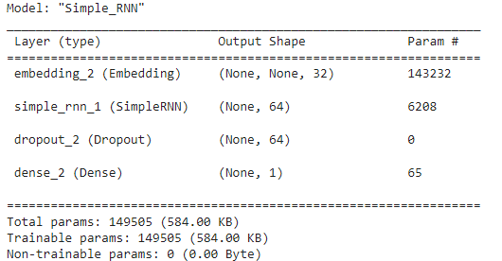
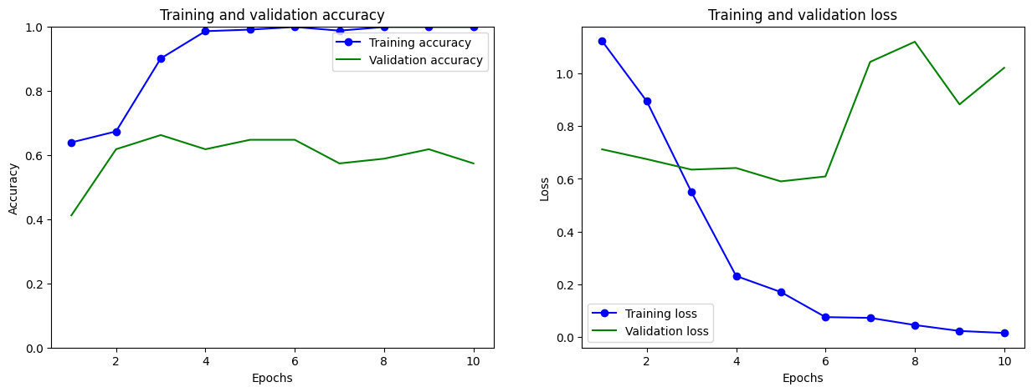
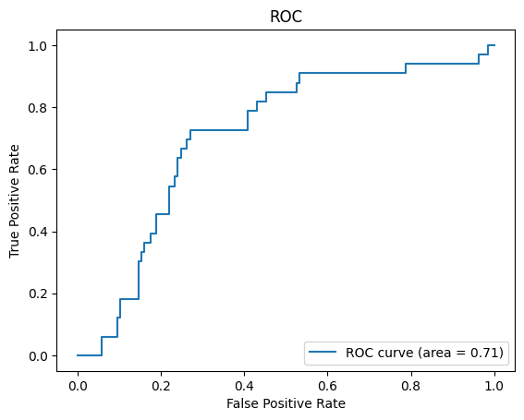
Simple RNN Model
Training accuracy: 99%
Test accuracy: 66 %
Area under the Receiver Operator Characteristic Curve (ROC) (AUC): 0.71
Model seems to be overfitting the training data.

Slide 11
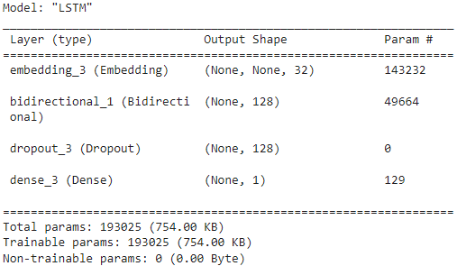
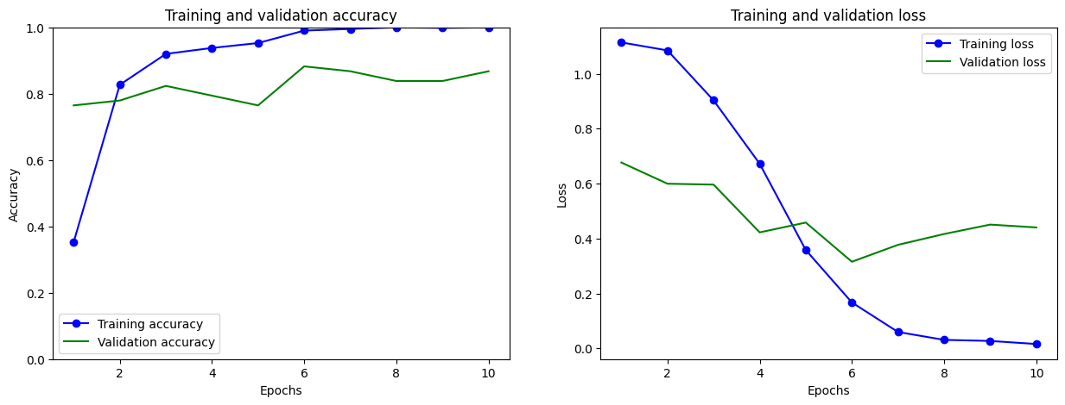
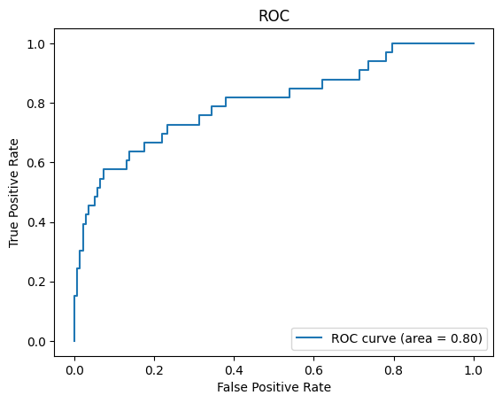
LSTM Model
Training accuracy: 100%
Test accuracy: 0.85 %
Area under the Receiver Operator Characteristic Curve (ROC) (AUC): 0.80
Model is an improvement over Simple RNN but still shows overfitting behavior.

Slide 12
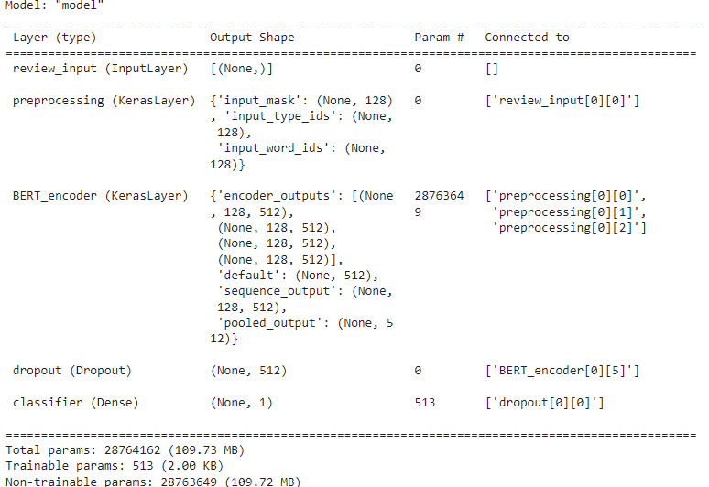
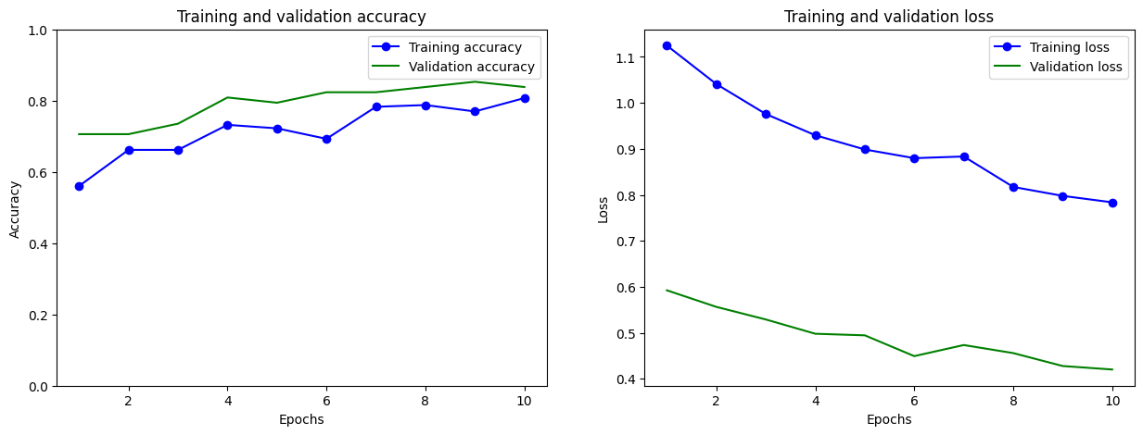
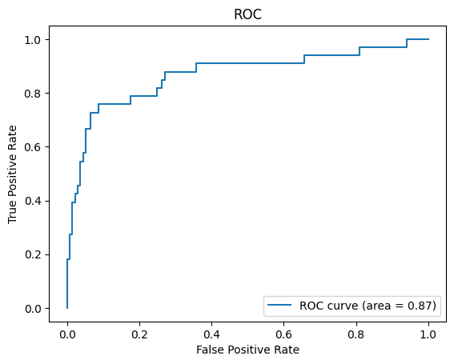
Transfer learning Model
Training accuracy: 81%
Test accuracy: 85 %
Area under the Receiver Operator Characteristic Curve (ROC) (AUC): 0.87
Model seems to be showing less overfitting than both LSTM and Simple RNN.

Slide 13
Hyperparameter tuning
LSTM model was selected as the best model for further analysis because it:
achieved above 80% accuracy target
is a less complex and smaller model (in size) than the BERT model
Hyperparameters:
Dropout rate
Learning rate

Slide 14
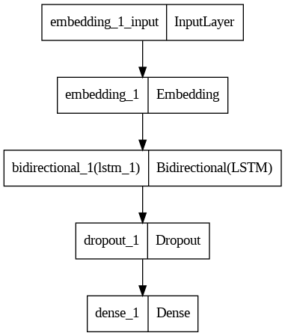
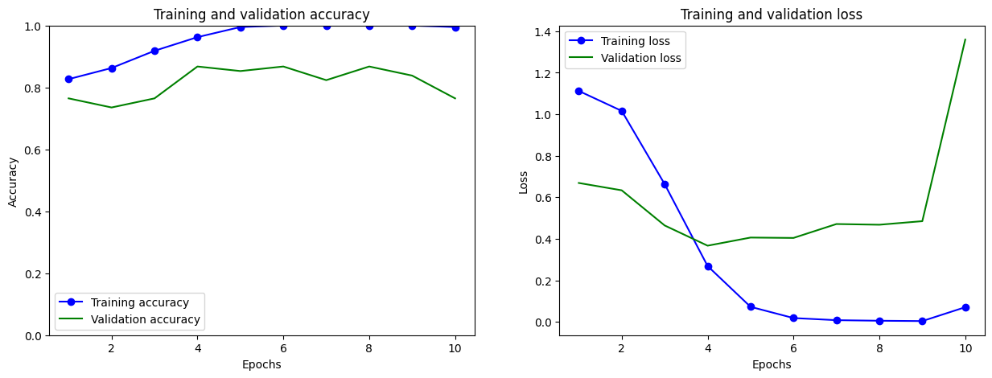
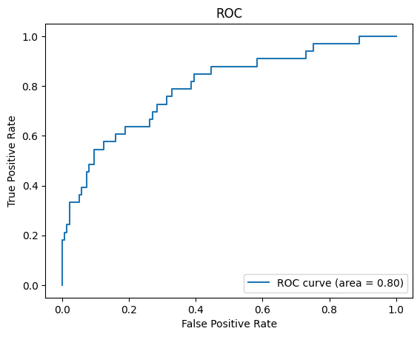
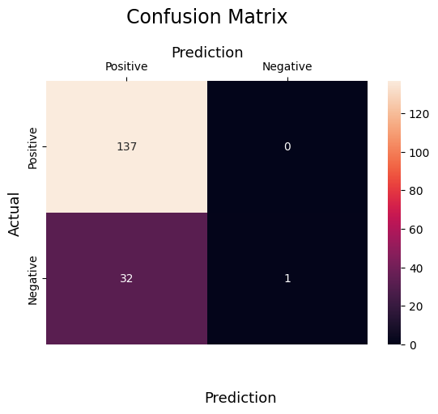
Hyperparameter Tuning results
Best parameters: Dropout rate: 25%, 0.002
Training Accuracy: 99.5%
Test Accuracy: 81.1%
Model seems to show signs of overfitting. Rate of predictions for the positive and negative classes are 3% and 100%, respectively. Imbalance should be addressed during hyperparameter tuning.

Slide 15
conclusion
Business recommendations:
Investigate if marketing campaign addressing start-of-week blues could improve ratings, sales at Starbucks.
Design fall/holiday focused menus that leverage general optimism of the seasonal change.
Dig into campaigns/events that were run in 2017 to see if they truly drove increased sales; consider reusing them.
Create surveys for store employees and customers to collect feedback to better understand if there are opportunities for improvement in customer service, wait times, payment methods and drive thru service.
The LSTM model predicted customer sentiment with 81% accuracy.
It is likely overfit.
Continue to monitor how it performs on new review data.
Consider using the transfer learning model instead to improve performance on unseen data.

Slide 16

Thank you
Temilola Famakinwa
734-802-9928
tefamakinwa@gmail.com
www.linkedin.com/in/famakinwatemilola/

